Slide 1
project: Algonix custom machine learning library
1
2
BHUSHAN SANJAY ZADE (MS2421)
VAISHNAV .C. MANKAR
(MS2409)
Department of Scientific Computing, Modeling and Simulation SPPU PUNE University
10 May 2025

Slide 2
INTRODUCTION:
1
Algonix is a self-developed machine learning library built from scratch with the goal of gaining a deeper understanding of core ML algorithms. Rather than relying solely on existing frameworks, Algonix focuses on implementing fundamental and advanced algorithms manually to strengthen conceptual clarity and practical coding skills.
🎯 Purpose
To build hands-on familiarity with machine learning algorithms by implementing them from the ground up.
To understand the inner workings, mathematical foundations, and performance trade-offs of each algorithm.
To compare custom-built models directly with industry-standard implementations from libraries like scikit-learn.
2
02

Slide 3
IMPLEMENTATION
01
1
2
3
03

Slide 4
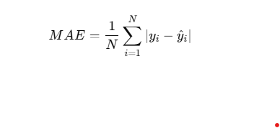
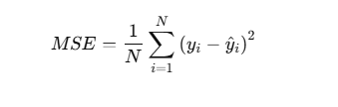

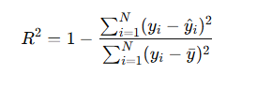
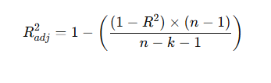
Performance Metrics (MAE,MSE,RMSE, R²,ADJUSTED R2)
1
2
3
4
5
07

Slide 5
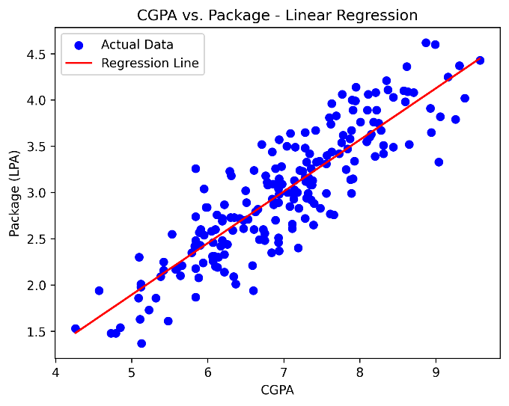
Simple Linear Regression
y=mx+c
1
SCIKIT LIBRARY ACCURACY
R2 SCORE : 0.780730147510384
MEAN ABSOLUTE ERROR : 0.2884710931878175
MEAN SQUARED ERROR : 0.12129235313495527
ROOT MEAN SQUARED ERROR : 0.34827051717731616
CUSTOM IMPLEMENTATION ACCURACY
R2 SCORE : 0.780730147510384
MEAN ABSOLUTE ERROR : 0.2884710931878175
MEAN SQUARED ERROR : 0.12129235313495527
ROOT MEAN SQUARED ERROR : 0.34827051717731616
2
04

Slide 6
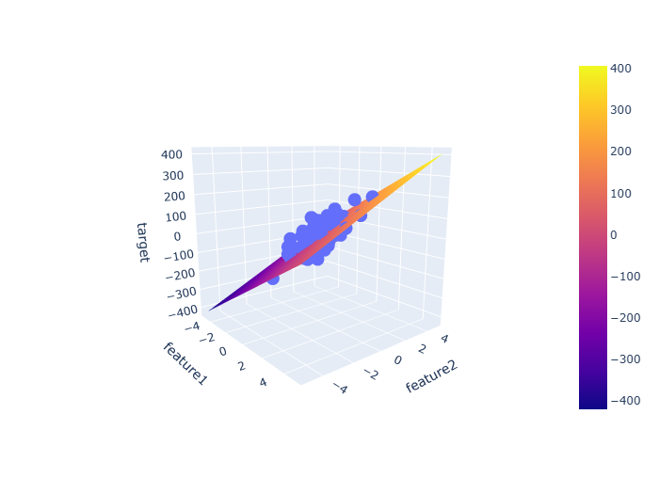
Multiple Linear Regression
y=b0​+b1​x1​+b2​x2​+⋯+bn​xn​
1
SCIKIT LIBRARY ACCURACY
R2 SCORE : 0.4399338661568968
MEAN ABSOLUTE ERROR : 45.21303419046903
MEAN SQUARED ERROR : 3094.4566715660626
ROOT MEAN SQUARED ERROR : 55.627840795469155
CUSTOM IMPLEMENTATION ACCURACY
R2 SCORE : 0.43993386615689756
MEAN ABSOLUTE ERROR : 45.213034190469
MEAN SQUARED ERROR : 3094.456671566058
ROOT MEAN SQUARED ERROR : 55.62784079546912
2
05

Slide 7
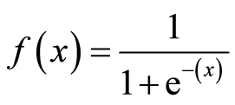
Logistic Regression
SKLEARN ACCURACY: 0.875
PRECISION: 0.772727272727272
RECALL: 1.0
F1SCORE:0.8717948717948718
CONFUSION MATRIX:
[[18 5]
[ 0 17]]
ALGONIX ACCURACY: 0.85
PRECISION: 0.7619047619047619
RECALL: 0.9411764705882353
F1 SCORE: 0.8421052631578947
CONFUSION MATRIX:
[[18 5]
[ 1 16]]
05

Slide 8
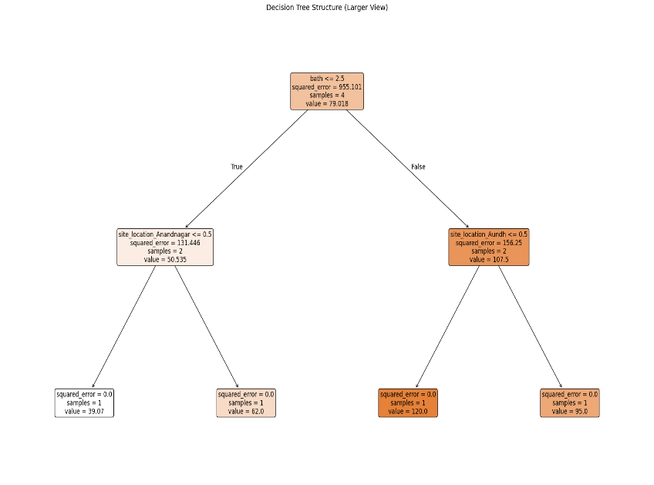
Decision Tree
1
SCIKIT LIBRARY ACCURACY
R2 SCORE : 0.4756986562313
MEAN ABSOLUTE ERROR : 39.9123564891
MEAN SQUARED ERROR : 9353.43124546
ROOT MEAN SQUARED ERROR : 97.20953075355716
CUSTOM IMPLEMENTATION ACCURACY
R2 SCORE : 0.459859615288256
MEAN ABSOLUTE ERROR : 40.10281389484881
MEAN SQUARED ERROR : 9449.692869326776
ROOT MEAN SQUARED ERROR : 97.20953075355716
2
08

Slide 9
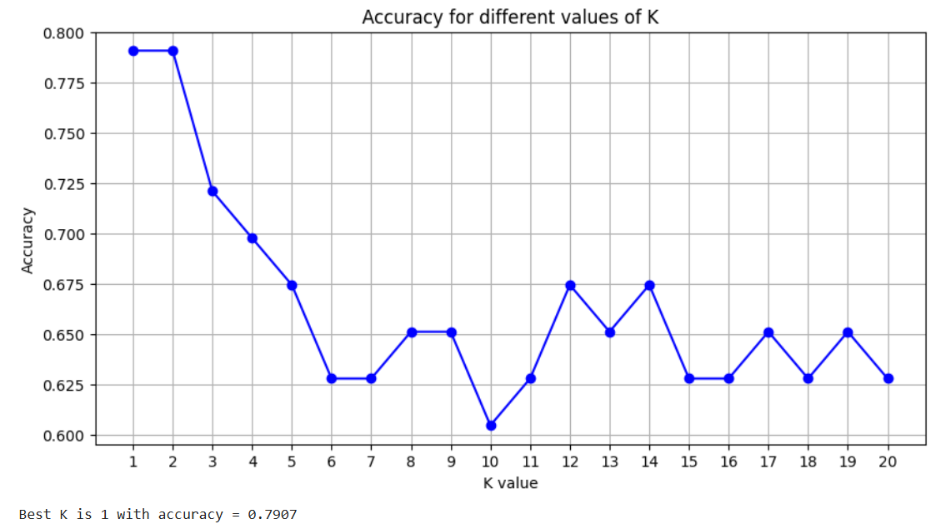
SCIKIT LIBRARY ACCURACY
WITH K = 3
ACCURACY : 0.9649
CUSTOM IMPLEMENTATION ACCURACY
WITH K = 3
ACCURACY : 0.9649
SCIKIT LIBRARY ACCURACY
WITH K = 1
ACCURACY : 0.7907
CUSTOM IMPLEMENTATION ACCURACY
WITH K = 1
ACCURACY : 0.7907
K Nearest Neighbors (KNN)
1
CUSTOM IMPLEMENTATION ACCURACY
WITH K = 1
ACCURACY : 0.7907
2
10

Slide 10
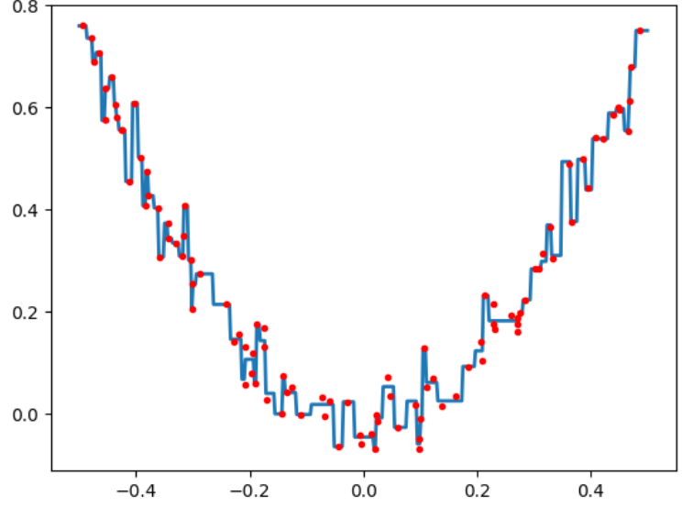
GREADIENT BOOSTING REGRESSION
GREADIENT BOOSTING CLASSIFICATION
SCIKIT LIBRARY ACCURACY
ITERATION = 100
ACCURACY : 0.9561
CUSTOM IMPLEMENTATION ACCURACY
ITERATION = 100
ACCURACY : 0.9561
SCIKIT LIBRARY ACCURACY
ITERATION = 100
ACCURACY : 0.7403
CUSTOM IMPLEMENTATION ACCURACY
ITERATION = 1
ACCURACY : 0.7597
SCIKIT LIBRARY ACCURACY
R2 SCORE : 0.8121
MEAN ABSOLUTE ERROR : 0.33
ROOT MEAN SQUARED ERROR : 0.50
ALGONIX ACCURACY
R2 SCORE : 0.8016
MEAN ABSOLUTE ERROR : 0.34
ROOT MEAN SQUARED ERROR :0.51
11

Slide 11
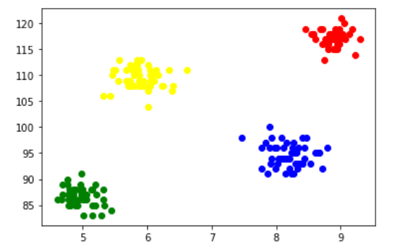
K-MEANS CLUSTERING
SCIKIT LIBRARY ACCURACY
CLUSTER = 2
ACCURACY : 0.8541
1
CUSTOM IMPLEMENTATION ACCURACY
CLUSTER = 2
ACCURACY : 0.8541
SCIKIT LIBRARY ACCURACY
CLUSTER = 3
ACCURACY : 0.893
CUSTOM IMPLEMENTATION ACCURACY
ITERATION = 3
ACCURACY : 0.666
2
13

Slide 12
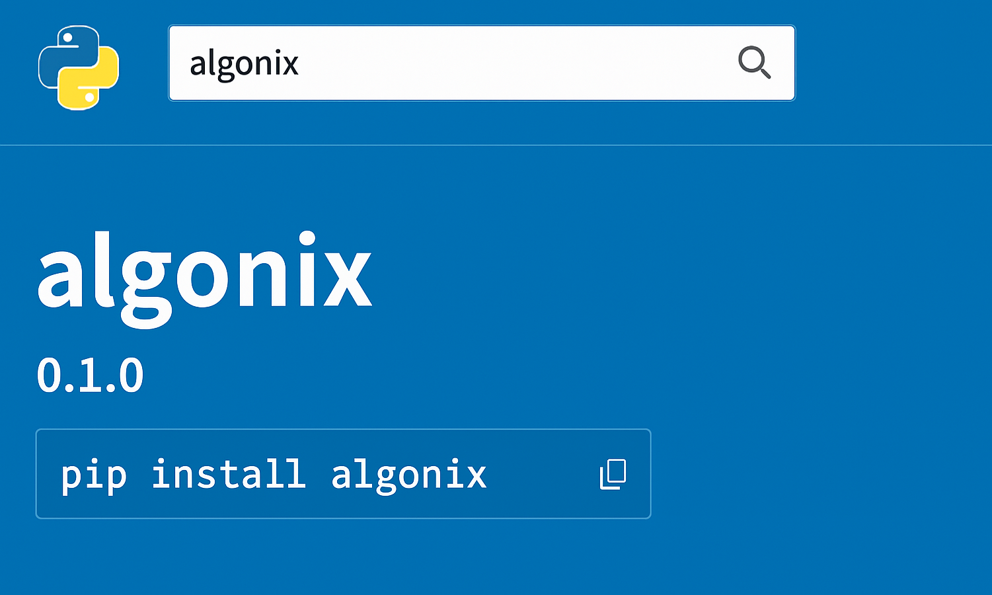
Welcome to **Algonix**, a lightweight, beginner-friendly machine learning library built from scratch using Python and NumPy.
Designed for learning and experimentation, this library provides transparent implementations of core ML algorithms without relying on external ML frameworks.
https://pypi.org/project/algonix/
16

Slide 13
CONCLUSIONS
1
2
In conclusion, the comparative study of a custom machine learning library against Scikit-Learn provides valuable insights into the implementation of fundamental regression algorithms. The exploration of topics such as optimization, regularization, and performance metrics reveals the practical trade-offs between creating custom solutions and utilizing established libraries. This study emphasizes the importance of understanding both the theoretical and pctical aspects of machine learning, enhancing real-world application capabilities.
16

Slide 14
Thank you!
1
2
3
1
2
Do you have any questions?
3
4
https://github.com/bhushanzade02
https://github.com/VaishnavMankar
5
17

